Slide 1

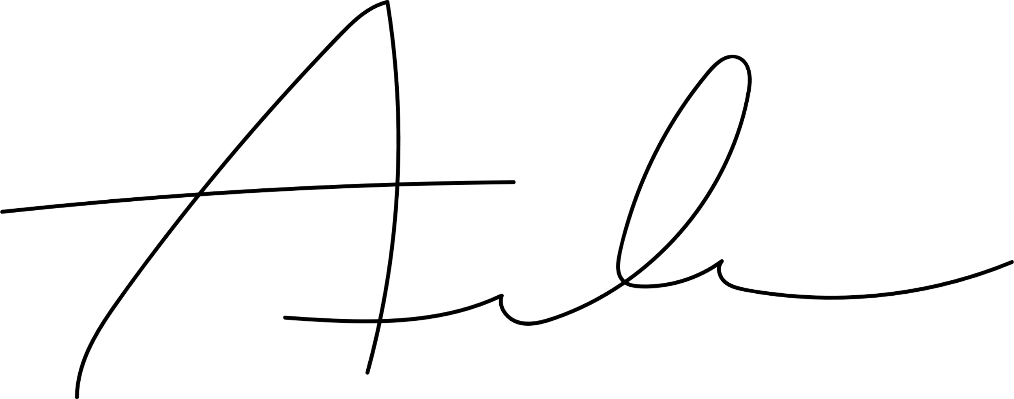

abc
Certificate of completion
This is to certify that
has completed to satisfaction Accounting 101. Completed on date for 18 Continuing Education Credits.
Anshu Benjaree
Aiko Watanabe
Vice President
Director

